Slide 1


Journey Presentation Week-7
Mohammad Aadil Sehrawat
Employee ID: 654985

Slide 2
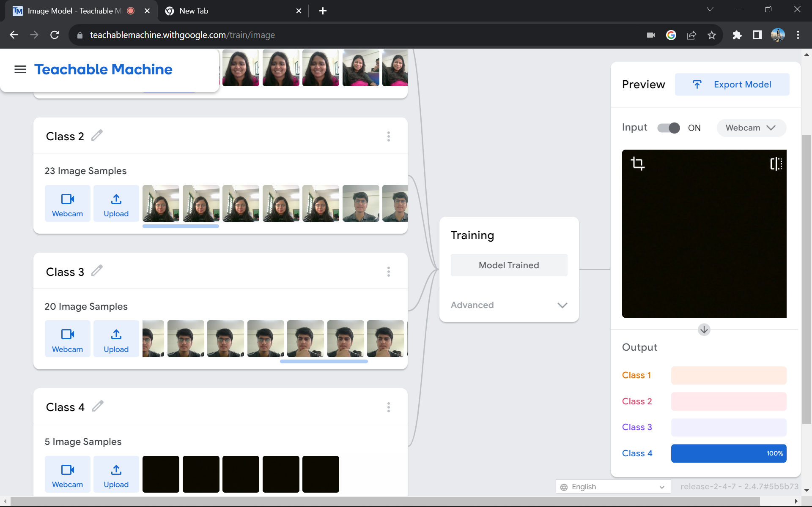
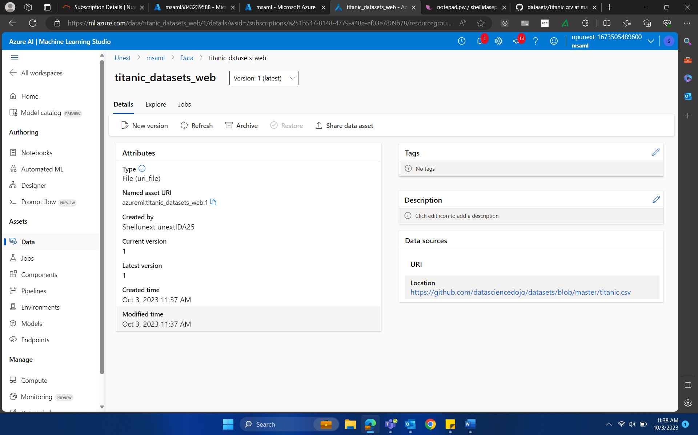
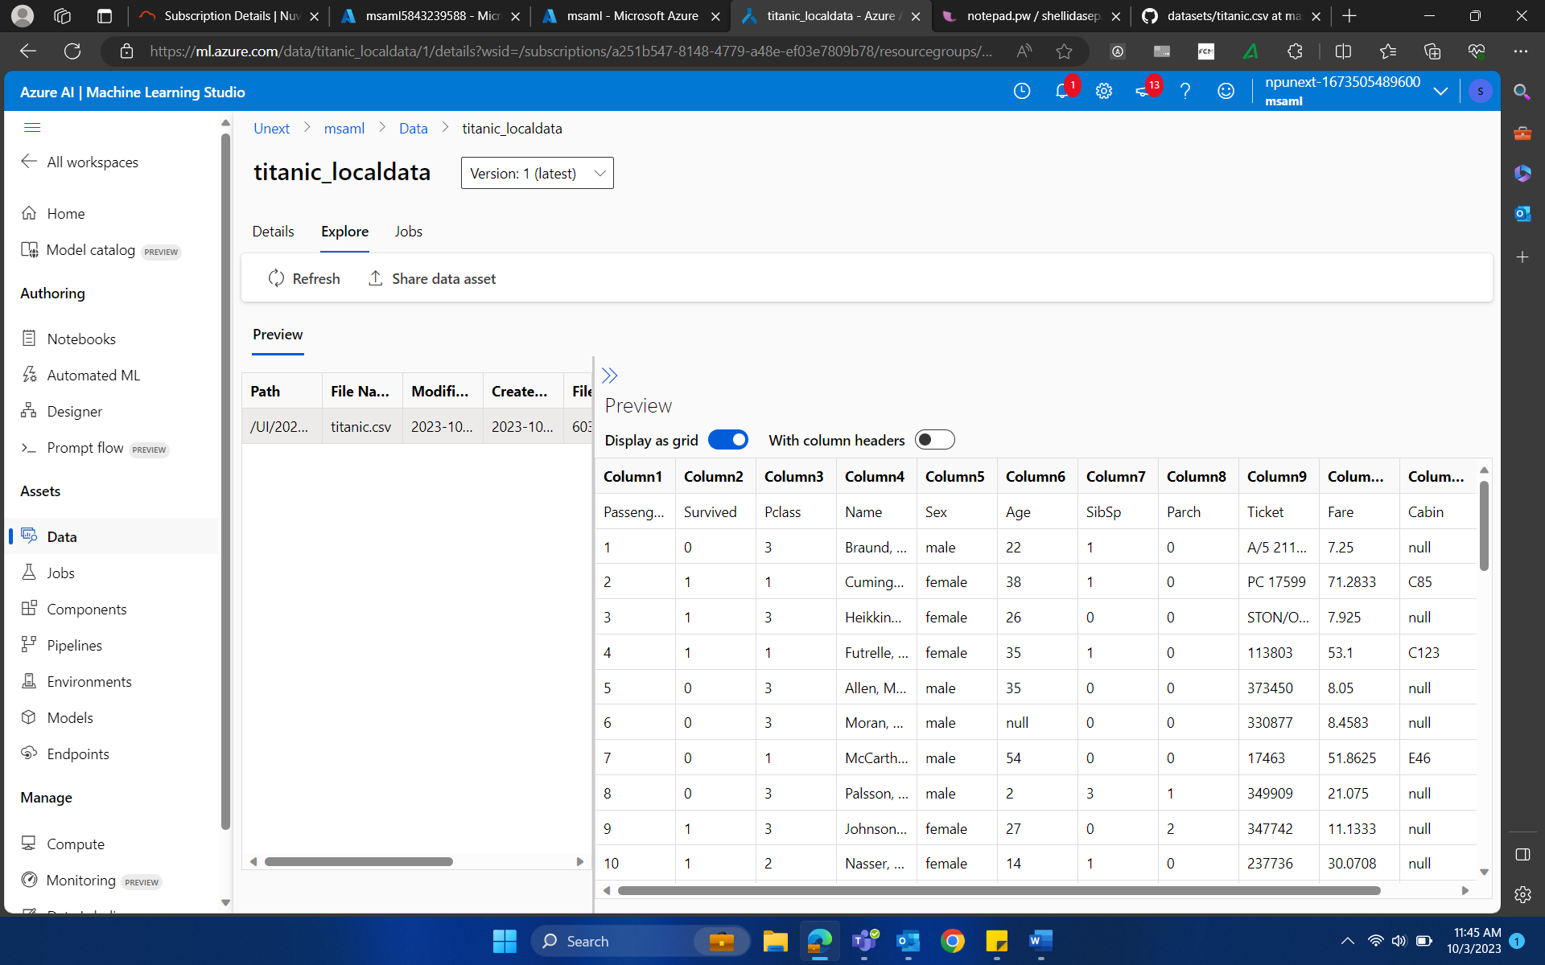
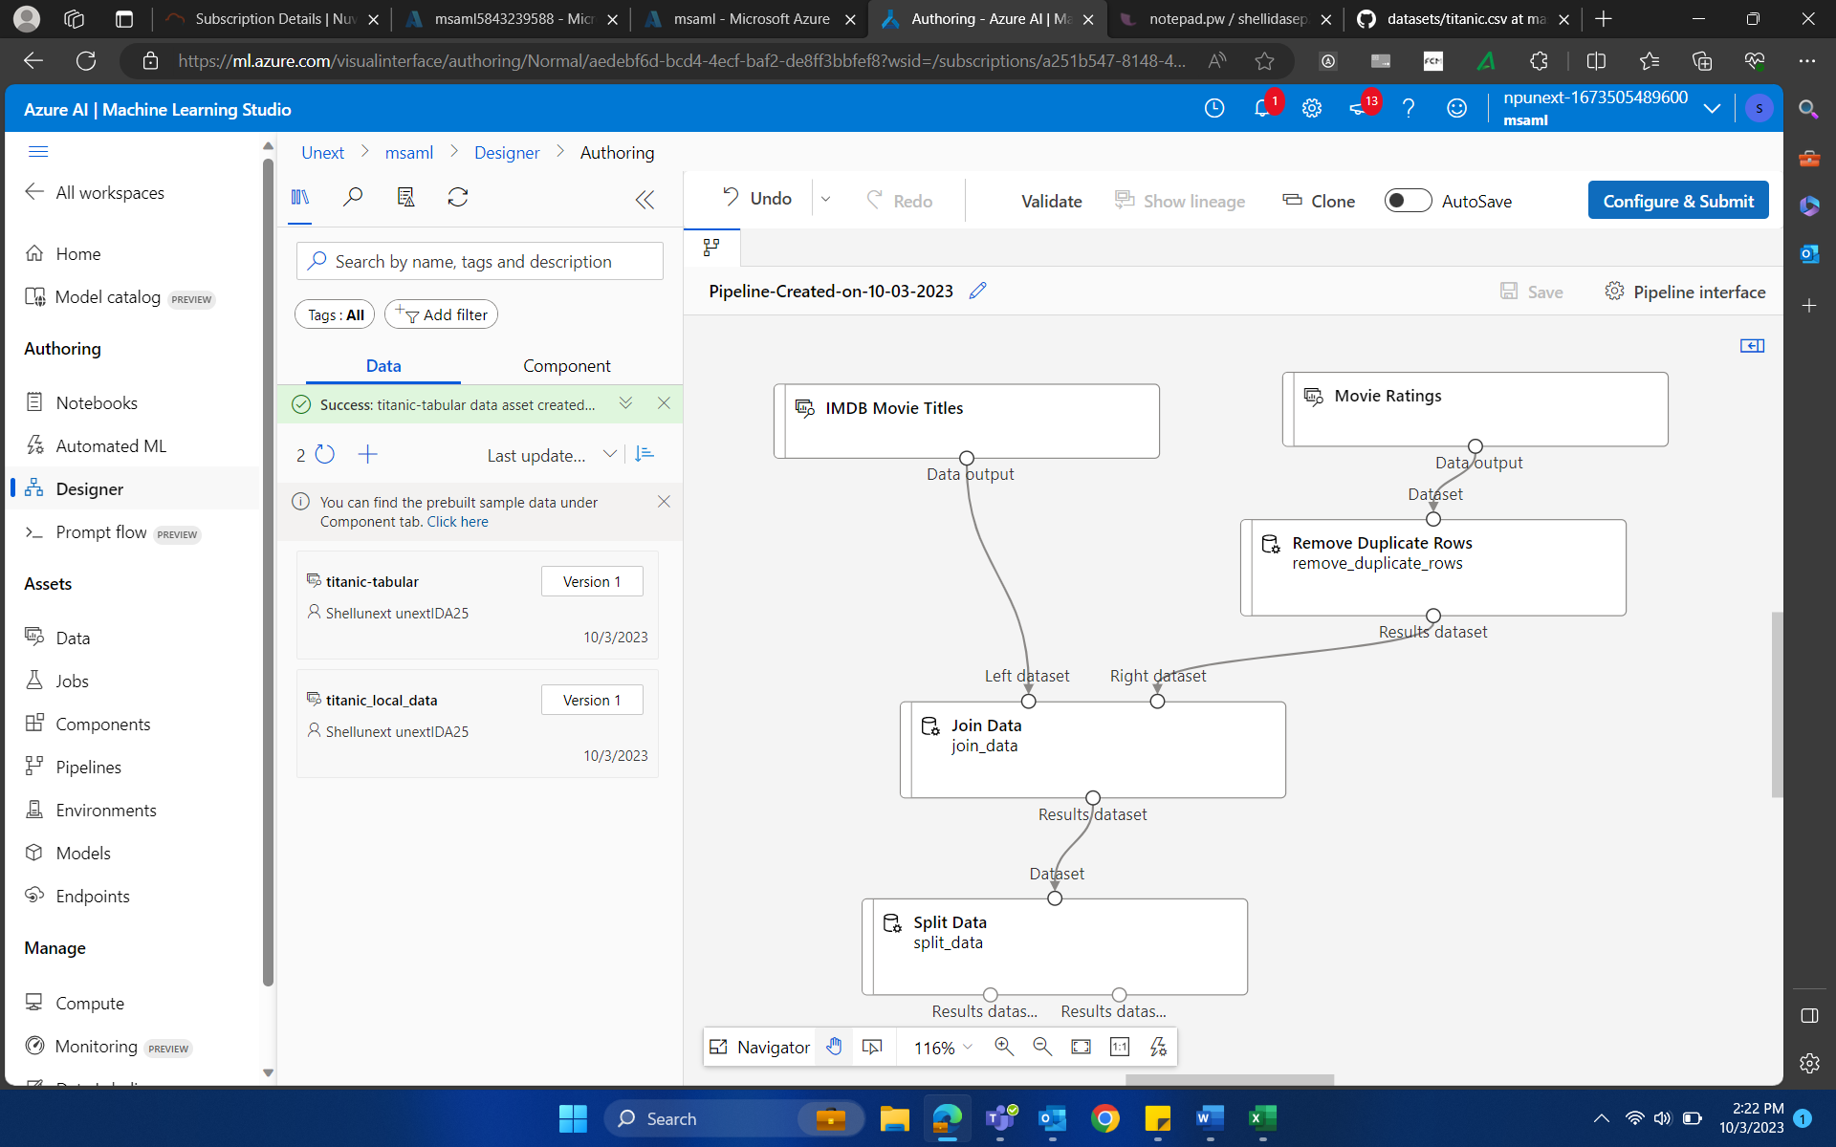
03-Oct-23 (Tuesday) – ML Studio

Slide 3
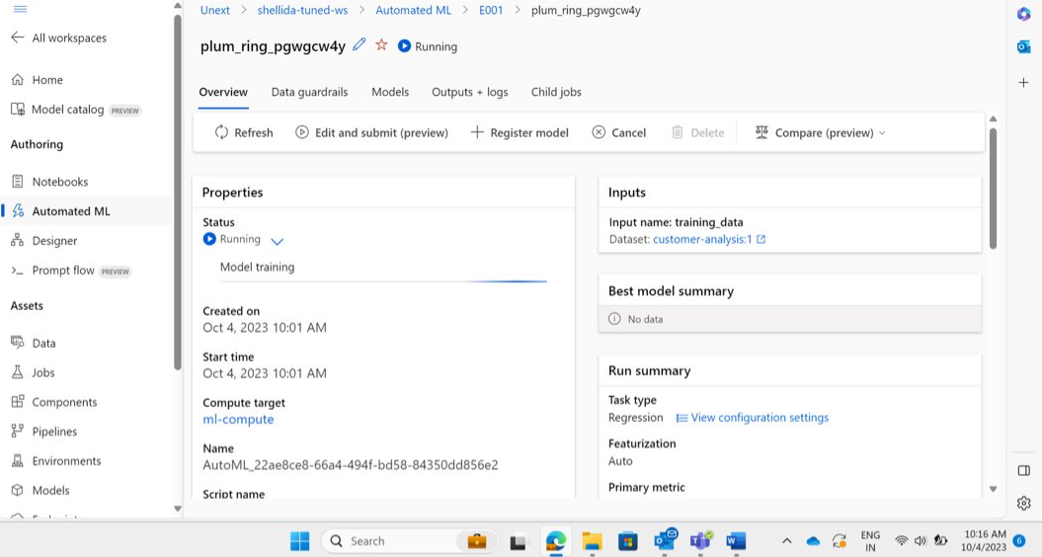
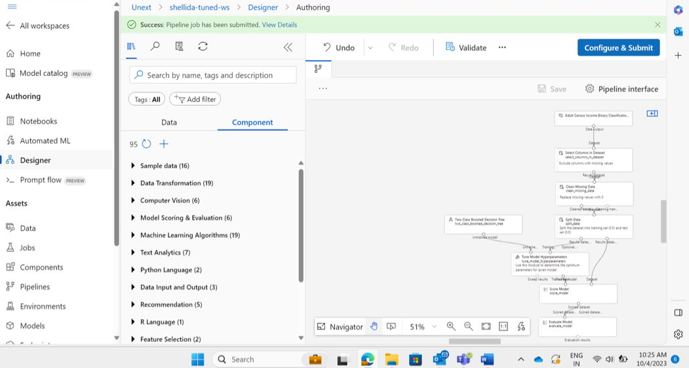
04-Oct-23 (Wednesday) – ML Studio

Slide 4
THANK YOU

